Slide 1
VMware vSphere 7.0: Install, Configure, Manage

Slide 2

Course Introduction

Slide 3
Importance
As a vSphere administrator, you require knowledge about vSphere components and resources and how they work together in your environment. You also require practical skills in installing, deploying, and managing these components and resources. By developing your knowledge and skills, you can build and run a highly scalable vSphere virtual infrastructure.

Slide 4
Learner Objectives (1)
After completing this course, you should be able to meet the following objectives:
Install and configure ESXi hosts
Deploy and configure vCenter Server Appliance
Use the vSphere Client to manage the vCenter Server inventory and the vCenter Server configuration
Create virtual networks with vSphere standard switches
Describe the storage technologies supported by vSphere
Configure virtual storage using iSCSI and NFS storage
Create and manage VMFS datastores
Use the vSphere Client to create virtual machines, templates, clones, and snapshots
Create a content library for deploying virtual machines

Slide 5
Learner Objectives (2)
Manage virtual machine resource use
Migrate virtual machines with vSphere vMotion and vSphere Storage vMotion
Create and manage a vSphere cluster that is enabled with vSphere HA and vSphere DRS
Use vSphere Lifecycle Manager to perform upgrades to ESXi hosts and virtual machines

Slide 6
Course Outline
Course Introduction
Introduction to vSphere and the Software-Defined Data Center
Virtual Machines
vCenter Server
Configuring and Managing Virtual Networks
Configuring and Managing Virtual Storage
Virtual Machine Management
Resource Management and Monitoring
vSphere Clusters
vSphere Lifecycle Management

Slide 7
Typographical Conventions
The following typographical conventions are used in this course.
Conventions | Usage and Examples
Monospace | Identifies command names, command options, parameters, code fragments, error messages, filenames, folder names, directory names, and path names: Run the esxtop command. ... found in the var/log/messages file.
Monospace Bold | Identifies user inputs: Enter ipconfig /release.
Boldface | Identifies user interface controls: Click the Configuration tab.
Italic | Identifies book titles: vSphere Virtual Machine Administration
< > | Indicates placeholder variables: <ESXi_host_name> ... the Settings/<Your_Name>.txt file

Slide 8
References (1)
Title | Location
vSphere Installation and Setup | https://docs.vmware.com/en/VMware-vSphere/index.html
vCenter Server and Host Management | https://docs.vmware.com/en/VMware-vSphere/7.0/com.vmware.vsphere.vcenterhost.doc/GUID-3B5AF2B1-C534-4426-B97A-D14019A8010F.html
vSphere Virtual Machine Administration | https://docs.vmware.com/en/VMware-vSphere/7.0/com.vmware.vsphere.vm_admin.doc/GUID-55238059-912E-411F-A0E9-A7A536972A91.html
vSphere Networking | https://docs.vmware.com/en/VMware-vSphere/7.0/com.vmware.vsphere.networking.doc/GUID-35B40B0B-0C13-43B2-BC85-18C9C91BE2D4.html
vSphere Storage | https://docs.vmware.com/en/VMware-vSphere/7.0/com.vmware.vsphere.storage.doc/GUID-8AE88758-20C1-4873-99C7-181EF9ACFA70.html

Slide 9
References (2)
Title | Location
vSphere Security | https://docs.vmware.com/en/VMware-vSphere/7.0/com.vmware.vsphere.security.doc/GUID-52188148-C579-4F6A-8335-CFBCE0DD2167.html
vSphere Resource Management | https://docs.vmware.com/en/VMware-vSphere/7.0/com.vmware.vsphere.resmgmt.doc/GUID-98BD5A8A-260A-494F-BAAE-74781F5C4B87.html
VMware Compatibility Guide | https://vmware.com/resources/compatibility
VMware Configuration Maximums | https://configmax.vmware.com

Slide 10
VMware Online Resources
Documentation for vSphere: https://docs.vmware.com/
VMware Communities: http://communities.vmware.com
Start a discussion.
Access the knowledge base.
Access documentation, technical papers, and compatibility guides.
Access communities.
Access user groups.
VMware Support: http://www.vmware.com/support
VMware Hands-on Labs: http://hol.vmware.com
VMware Education: http://www.vmware.com/education
Access course catalog and worldwide course schedule.

Slide 11
VMware Education Overview
Your instructor will introduce other Education Services offerings available to you:
VMware Learning Paths:
Help you find the course that you need based on the product, your role, and your level of experience
Can be accessed at https://vmware.com/education
VMware Learning Zone, which is the official source of digital training, includes the following options:
﻿On-Demand Courses: Self-paced learning that combines lecture modules with hands-on practice labs
VMware Lab Connect: Self-paced, technical lab environment that lets you practice skills learned during instructor-led training
Certification Exam Prep: Comprehensive video-based reviews of exam topics and objectives to help you take your certification exam
For more information, see https://vmwarelearningzone.vmware.com.

Slide 12
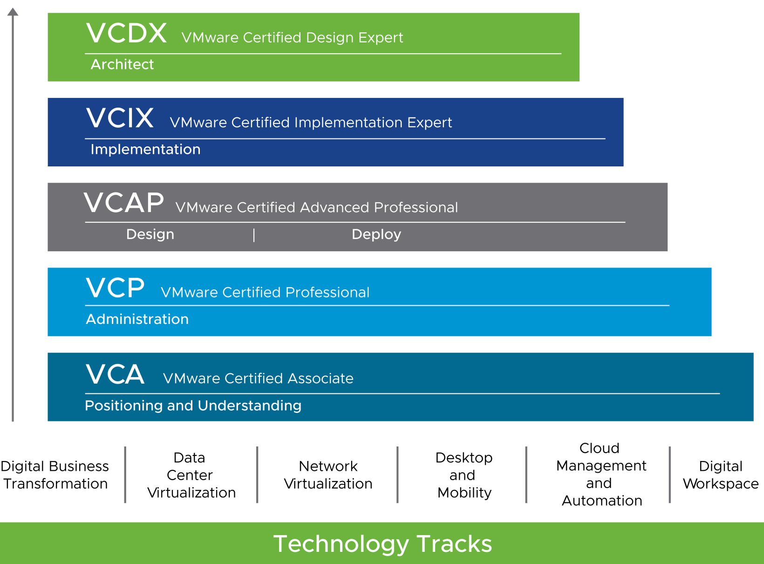
VMware Certification Overview
VMware certifications validate your expertise and recognize your technical knowledge and skills with VMware technology.
Notes:
VMware certification sets the standards for IT professionals who work with VMware technology. Certifications are grouped into technology tracks. Each track offers one or more levels of certification (up to five levels).
For the complete list of certifications and details about how to attain these certifications, see https://vmware.com/certification.

Slide 13
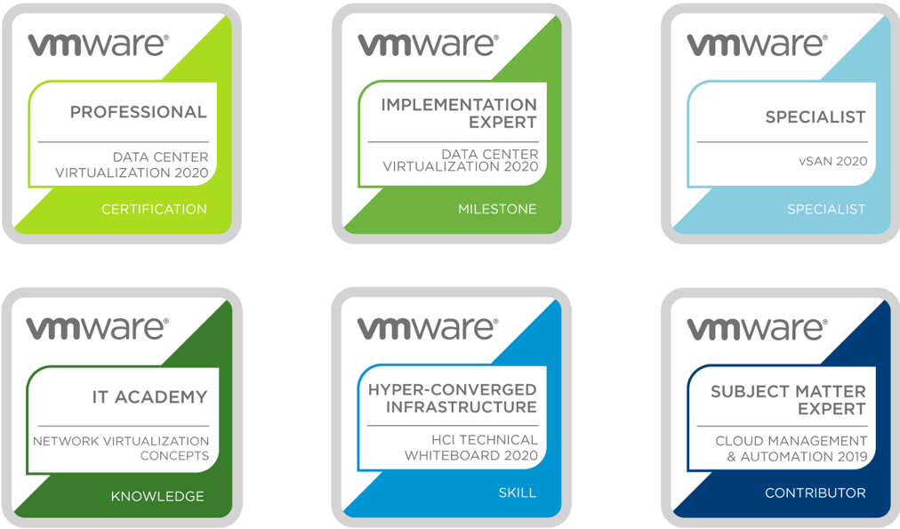
VMware Badge Overview
VMware badges are digital emblems of skills and achievements.
Notes:
Digital badges have the following features:
Easy to share in social media (LinkedIn, Twitter, Facebook, blogs, and so on)
Tethered to VMware to validate and verify achievement
Contain metadata with skill tags and accomplishments
Based on Mozilla's Open Badges standard
For the complete list of digital badges, see http://www.pearsonvue.com/vmware/badging.

Slide 14
Virtual Beans: Introduction
Virtual Beans is a coffee company that owns a chain of cyber cafés. Each café sells coffee drinks, snacks, and packaged coffee beans. Each café is also equipped with a variety of video games and high-speed Internet access.
Virtual Beans has an online store (vmbeans.com) where you can purchase coffee beans and various accessories.
Virtual Beans is a fast-growing company. After much success over the years, it went from a single, small café to a company that owns a chain of cafés spanning multiple cities. The online web store is also a huge success.
Virtual Beans recently purchased vSphere 7 for its data center.
You work as a system administrator at Virtual Beans. You will be part of the IT team in charge of deploying vSphere 7 in the data center. You are new to vSphere, but you have two years experience working for Virtual Beans.

